Slide 1

JehangirHospital
Home About Facility Review Contact
Stay Safe, Stay Healthy.
Caring For Your Life
Learn More

Slide 2

JehangirHospital
Home About Facility Review Contact
Ambulance Services
If the patient requires medical support during transport you
can avail of the 1066 ambulance (chargeable basis) which
is fully equipped with life support devices. In case you require
the above service, inform the ward staff
Emergency Rooms
The Emergency Room is one of the most critical areas
in the hospital. The protocol at our 24X7 Emergency Medicine
Department is designed to respond quicker and have proven
outcomes that are on par with the very best.
Emergency Numbers
020-66811066(LANDLINE)
8888881066(MOBILE)-EMERGENCY LIFELINE

Slide 3



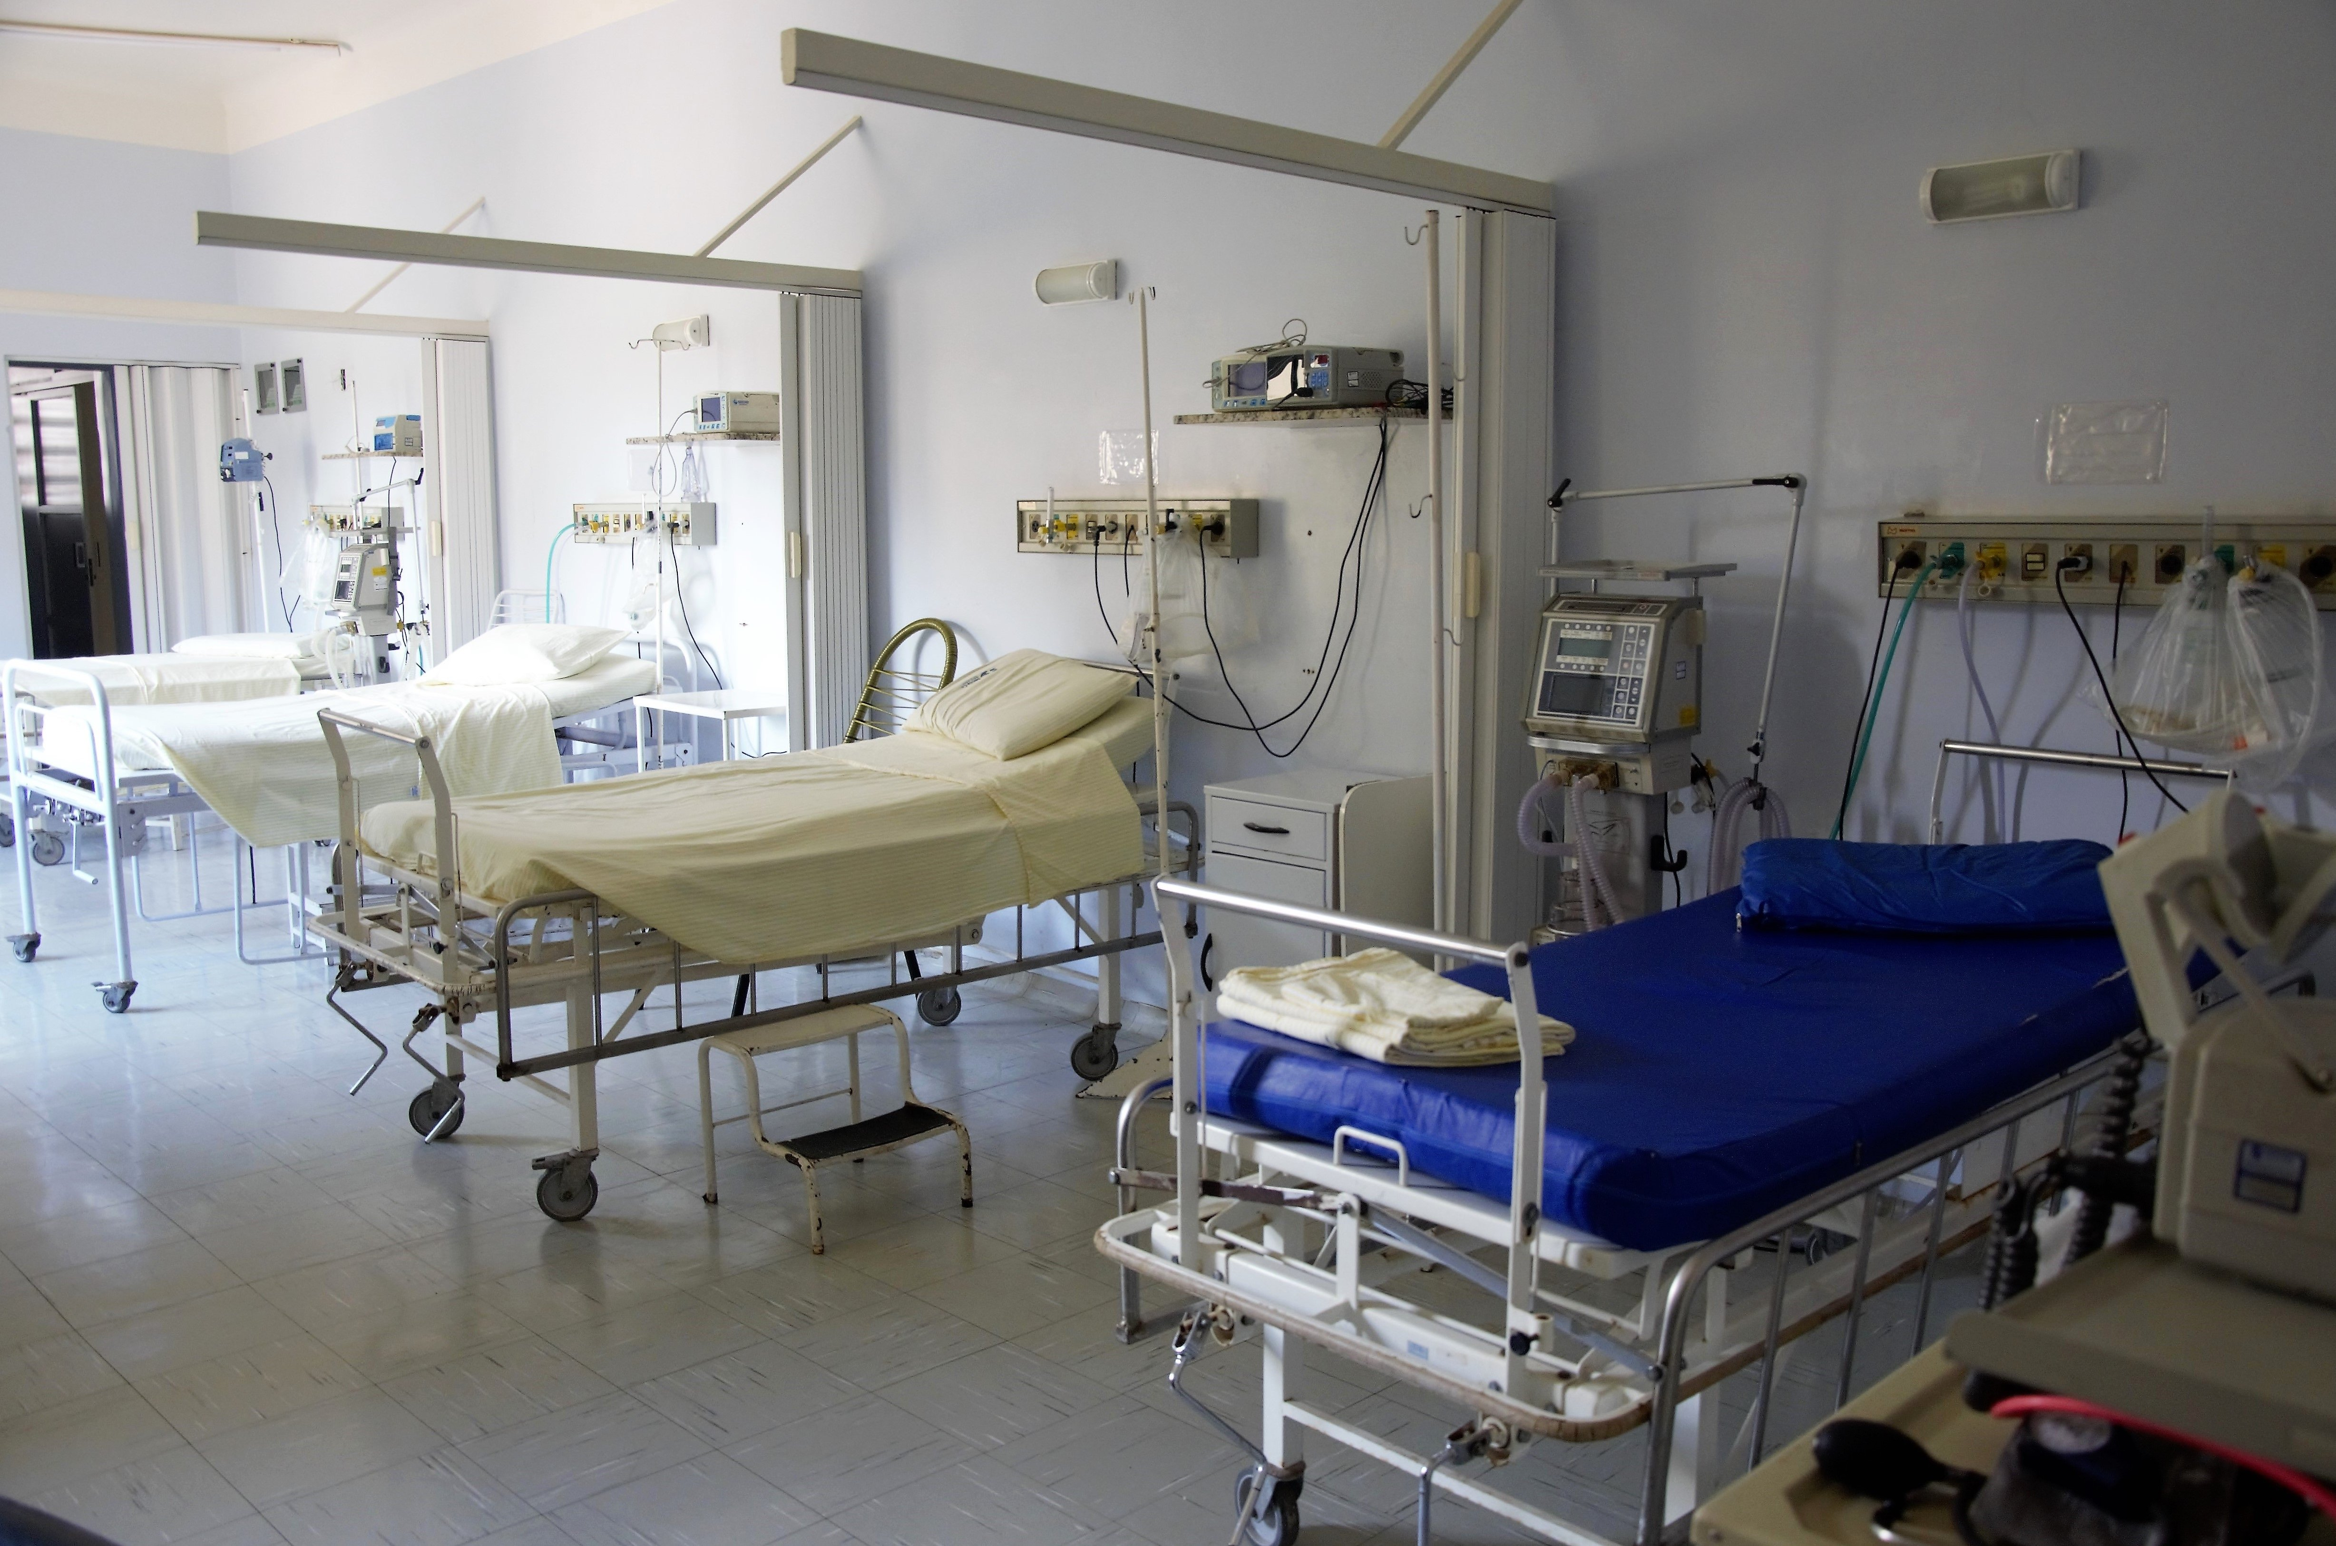


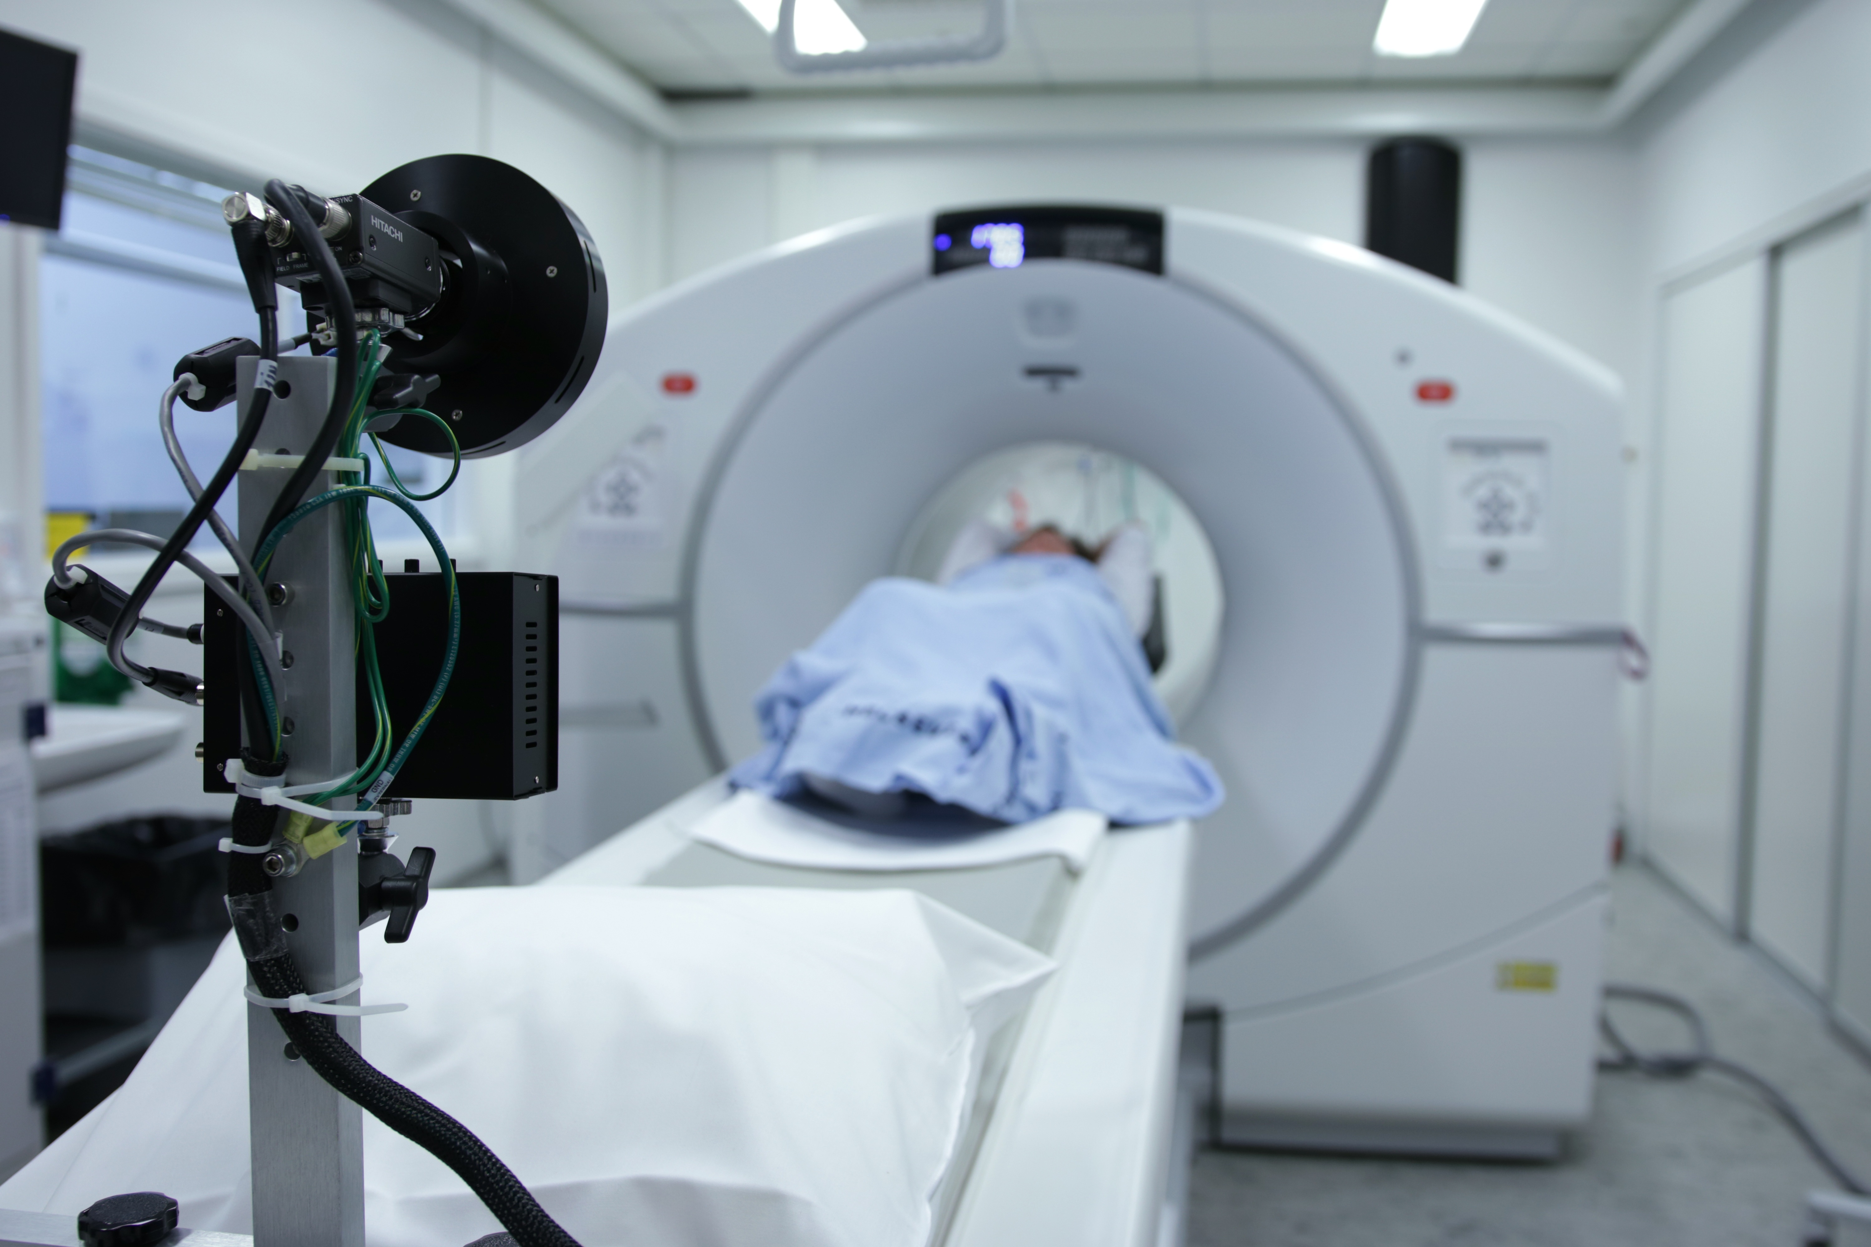
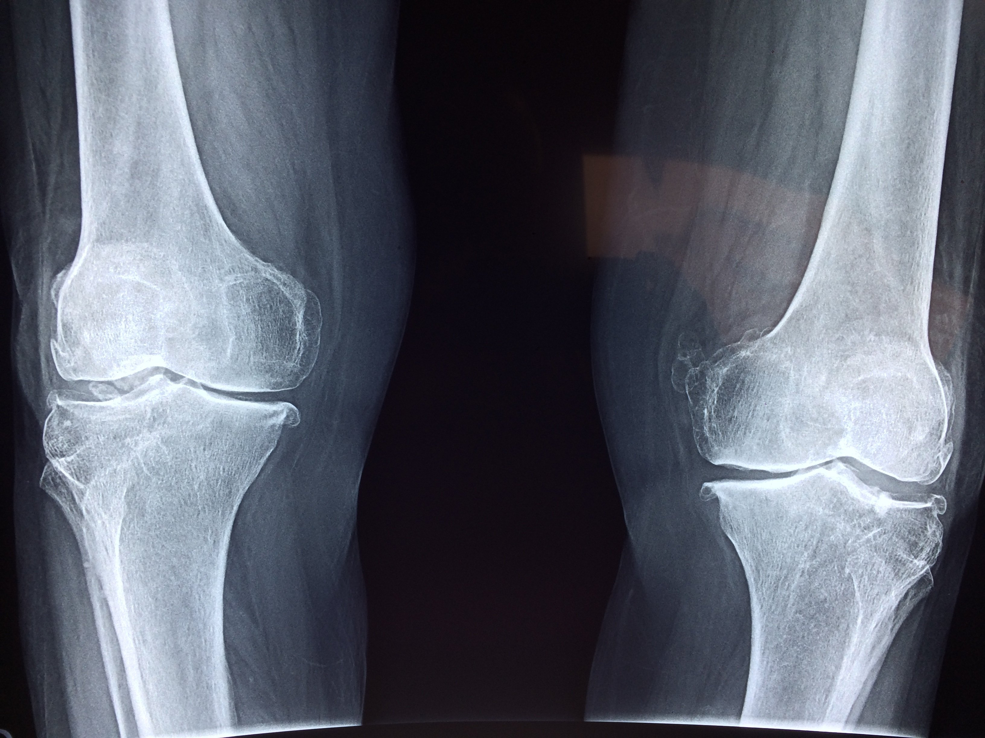
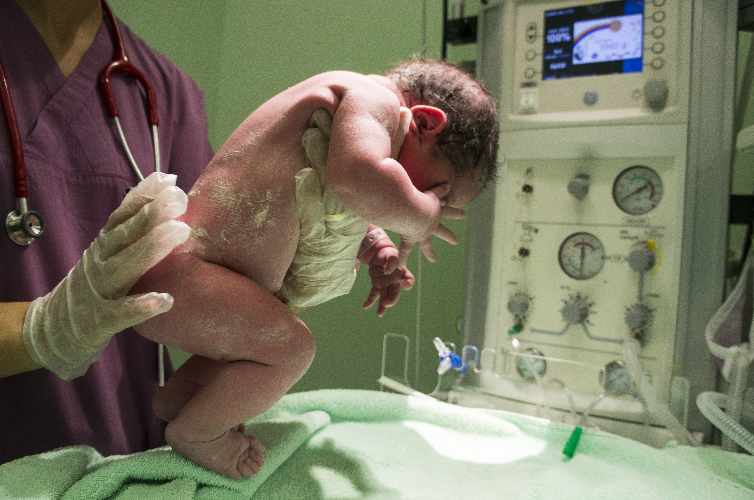
JehangirHospital
Home About Facility Review Contact
Our Facilities

Slide 4



JehangirHospital
Home About Facility Review Contact
People’s Review
I felt extremely happy with the professionalism. I had a good experience here, the staff here is very friendly and helpful. The food is good and hygienic. Housekeeping facilities and staff is very proactive, polite, and understanding. Nurses here are too good and helpful.
Doctor's team is excellent so as the nursing staff to Add Care.Doctors are serving the patients with best treatment to back them to enjoy their normal and healthy life as soon as possible.
The administration staff is helpful specially the Financial Councilling they strech their limit to help the patients.Finally when one got the discharge from hospital patient is really Added with Care.

Slide 5
JehangirHospital
Home About Facility Review Contact
Make An Appointment
Name:
Contact no.
Email:
Appointment Time:
Message ...
Make Appointment

